Slide 1
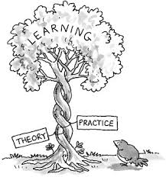
BULLS And Cows – An Entropy Based approach
Swetha Gendlur Nagarajan

Slide 2
Table of Content
Theoretical Background
What is Entropy
Practical Implication
Bulls and Cows - Analysis
How do we use it
Why do we use it in ML

Slide 3
What is Entropy?
Entropy is a fundamental concept in data science
Measures the amount of uncertainty or randomness present in a dataset.
Quantifies the information content within data, helping us understand and analyze hidden patterns and structures

Slide 4
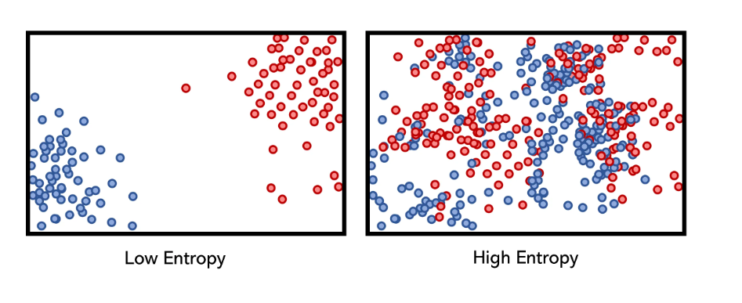
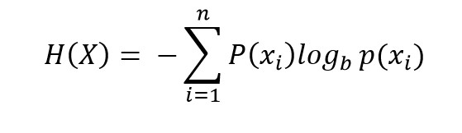
How do we use Entropy?
Imagine you have a bag of colored marbles. The entropy formula helps us understand how uncertain we are about which color we'll pick if we reach into the bag without looking.
If all marbles are the same color, there's no uncertainty (entropy = 0).
If there's an equal mix of colors, uncertainty is highest (maximum entropy).

Slide 5
Why Entropy is important?
Entropy is instrumental in identifying the most informative features in a dataset:
It helps select features with high information gain
Reduces the amount of data required for modeling
Improves the efficiency and accuracy of machine learning algorithms
In Bulls and Cows, using an entropy-based approach, players can:
Maximize the information gained from each guess
Eliminate the most possibilities with each move
Optimize the strategy for discovering the hidden combination
Theory
Practice

Slide 6
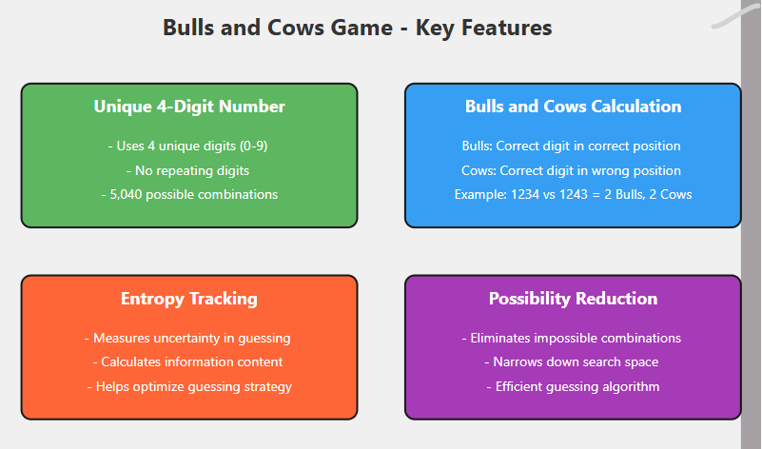

Slide 7
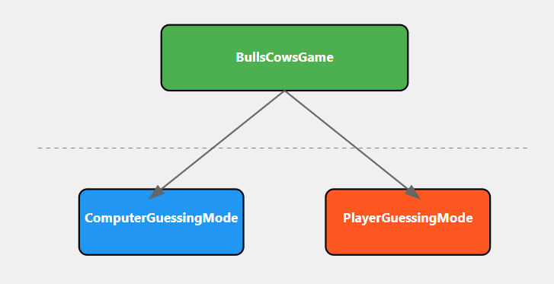
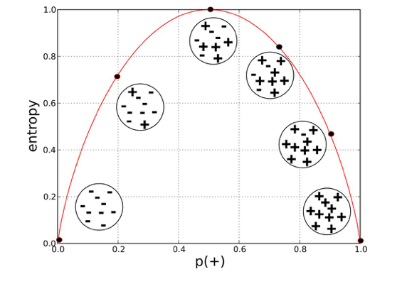
Bulls and Cows analysis
Here if the number in the guess matches with the secret number, then the possibility set gets reduced
The matching and filtering is done based on the algorithm,
Correct number in correct position and
Correct number in wrong position
This is how we select the feature and split the required data from the rest

Slide 8
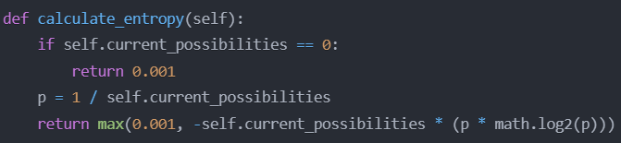
Bulls and Cows analysis
The entropy calculation - Shannon entropy formula, which is a fundamental concept in information theory
In this case, the entropy is calculated based on the current number of possible combinations (self.current_possibilities) and the probability p of any single combination being correct.
Lower entropy indicates that the game state is more certain and the computer/player is closer to finding the correct number.
By tracking the entropy, the game can make informed decisions about the best guessing strategy to minimize the number of attempts required to find the secret number.
Note: If the number of possibilities is 0, the function returns 0.001 instead of 0. This is likely a safeguard to prevent division by 0 errors later in the calculation.

Slide 9
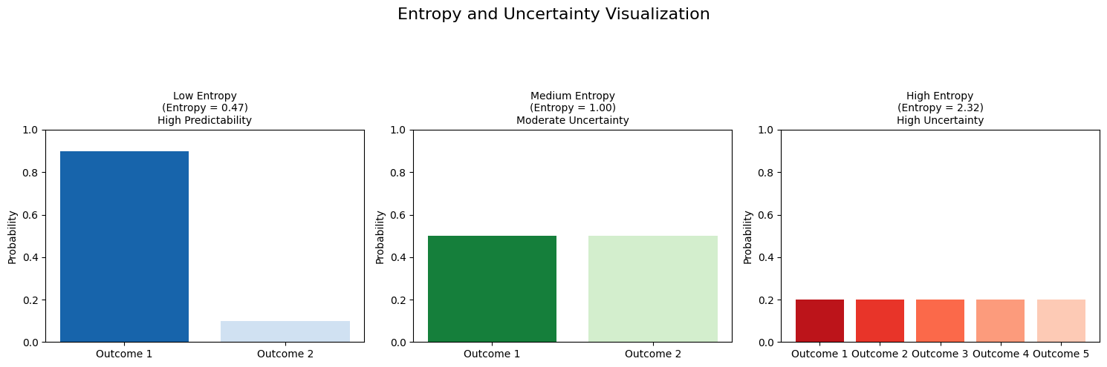
Optimal Algorithm
Computer Guess: It guesses the number within 4 Guesses Maximum
Player Guess: Worst case the player guess the number with 6 guesses using the possibilities set

Slide 10
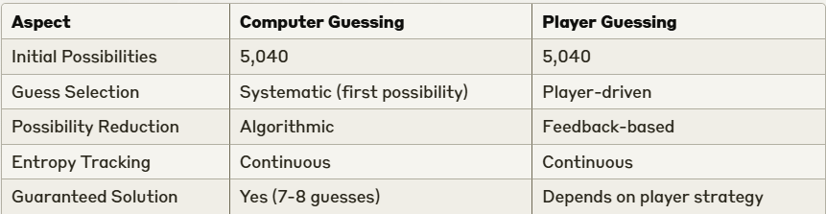
Bulls and Cows analysis
Comparative Analysis

